Slide 1

Membership is the Lifeblood of Our Order!
Recruiting – James Funaro

Slide 2
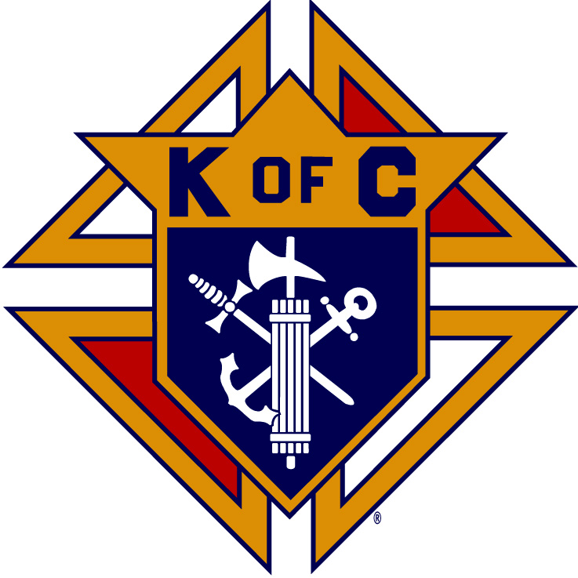
Agenda
How Important is Membership?
Do We Have a Winning Culture?
Quick Start

Slide 3
Point I
The Importance of Membership
Why Do We Have Quotas?
Startling Statistics!

Slide 4
21 million Catholic men are not members of a Catholic men’s organization
7 million men in the USA say they are willing to join the Knights of Columbus!!!
47% of members report they joined the Order because they were invited
33% of us have never asked men to join

Slide 5
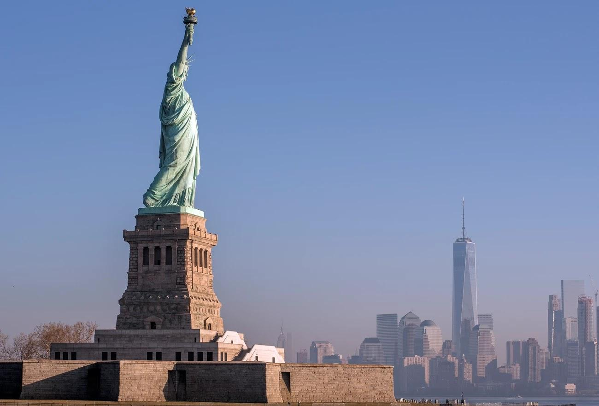
Point II
A Winning Culture Is Essential To Success!
Appreciation
Alignment
Belonging
Trust
Leadership!!!

Slide 6
Points
INSPIRE Growth and Create a Winning Culture
Be a Support & Resource
Hold Councils Responsible
Help councils Plan The Fraternal Year

Slide 7
Point III
QUICK START!!!
You can’t win Star Council/District/COH in JUL/AUG, but you can lose it!
We will have 4 designated Church
Drive Weekends

Slide 8
Gen. Norman Schwarzkopf
When placed in command, take charge!

